Slide 1
Architecting a Modern Data Platform July 28-30, 2020

Slide 2

Facilitator
Dan Sutherland
Distinguished Engineer & CTO - Data Platforms, Solution/Data Architect, 2xAWS Certified, Azure Certified, GBS

Slide 3
Defining a Reference Architecture
3
12 August 2020
IBM Services
© 2019 IBM Corporation

Slide 4
Reference architecture definition
When you construct a house or building there are always certain common components, such as
Foundations
Water infrastructure
Electrical infrastructure
Telecommunications
Heating and cooling
Similarly, there are common components that all data ecosystems share…
Requirements dictate design, and the Reference Architecture provides the blueprint.

Slide 5
Reference architecture purpose
A Comprehensive Reference Architecture has a Defined Purpose:
The Reference Architecture is meant to address the changes caused by the upheaval from the massive move from solely on premise to a hybrid and multi-cloud environment
It is meant to be a common blueprint for the client’s complex data environments and reflect a modern data architecture
The Reference Architecture is a guiding principle-based, layered architecture with clear definitions and recommended usage for each layer and component
The standards and guiding principles in this document can be used to train development teams, communicate the architecture to stakeholders and govern project designs
The Reference Architecture is meant to be a living document and a key governance tool for the client’s data management organization

Slide 6

Why is it Important?
It describes what the major foundational components or candidate building blocks of an end-to-end architecture solution, and it:
Spans all industries and all solution areas.
Provides a common language.
Provides a framework for scope identification, roadmap definition, risk assessment, and gap assessment.
A Reference Architecture reduces the complexity, cost, and risk of solution deployment and sets the foundation for business transformation.

Slide 7



Using a Reference Architecture as a sales and delivery tool
Using the Reference Architecture as a sales tool has proven extremely useful in:
Demonstrating our competency and thought leadership around BI
Making the client think:
”Maybe I don’t have all this….”
“Maybe I haven’t been approaching this right….”
“Maybe I need some outside help…..”
“I like this idea of pre-integrated solutions—some one else has gone through the pain so I don’t have to….”
Positioning our software products and partnering strategy as being part of a well thought-out, integrated architecture
Include it in sales presentations and in proposals.

Slide 8
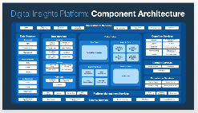
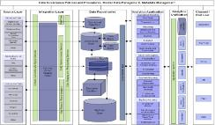
On most projects we follow a Best Practice Architectural Taxonomy
Data Platform Reference Architecture:
It describes what the major foundational components or candidate building blocks of an end-to-end architecture target solution should be.
It spans all industries and all solution areas.
It provides a common language for describing architectural components.
It provides a framework for scope identification, roadmap definition, risk assessment, and gap assessment.
It provides a common framework for conceptualizing the problem space.
Contextual
Conceptual Architecture (optional):
Derived from Digital Insights Platform Reference Architecture as an optional step
Client and Solution-specific
Is close to business definitions, business processes, and enterprise standards
Is stable over time and can be augmented as new business needs arise
Is owned by data stewards, enterprise data architects, and governance groups
Conceptual
Logical Architecture:
Translates conceptual into logical and is client and solution-specific
Takes into consideration existing data elements, functions, processes, and their relationships
Is responsible for presenting a view of the enterprise data for user and processes consumption
Is owned by logical data modelers, enterprise architects, and business analysts
Is use case/LOB/Business area and/or vendor/tool specific, with the specific data domains, components, and services that are in scope for the solution being defined
Logical
Physical Architecture (project and client-specific):
Is an implementation specific rendering with all the specifics behind each component being included as part of the physical solution
Translates the logical architecture into physical structures
Is designed for optimal performance
Is usually dynamic and evolves with technology advancements
Is owned by DBAs, system administrators, and IT architects
Physical

Slide 9
Architecture types and levels
Types of architecture | Functional architecture: It lists all the functions necessary to support processes and data. Data architecture: It defines the domain, types, and uses for each layer in the architecture. Process architecture: It determines how data and functions interact.
Levels of architecture | Conceptual: It is close to business definitions, business processes, and enterprise standards. It is stable over time and can be augmented as new business needs arise. It is owned by data stewards, enterprise data architects, and governance groups. Logical: It translates conceptual design into logical data design. It takes into consideration existing data elements, functions, processes, and their relationships. It is responsible for presenting a view of the enterprise data for user and processes consumption. It is owned by logical data modelers, enterprise architects, and business analysts. Physical: It translates the logical design into physical structures. It is designed for performance. It is usually dynamic and evolves with technology advancements. It is owned by design DBAs, system administrators, and IT architects.

Slide 10
Digital Insight Reference Architecture for enabling data-driven Enterprise
Key characteristics
Support hybrid Cloud
Microservices
Common Data quality check, business rules and validation
Single source & version of Truth
Analyst sandbox
Polyglot storage
3 Tiered data architecture
API-based access
Managed data platform
Dimensional Data
Dimensional Data
Conformed Data
1. Data Source Layer
3. Data Lake
5. Content Services
7. Orchestration Services
9. Security Services
2. Data Fabric
4. Cognitive Services
6. Experience Services
8. Platform Management

Slide 11
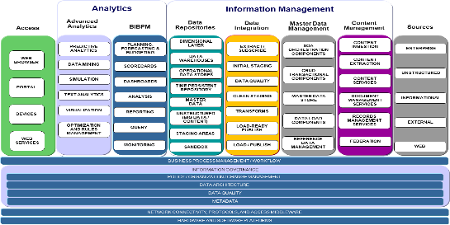
IBM Reference architectures – current and past
Digital Insights Cognitive Enterprise (DICE)
Big Data & Analytics (Data Lake) Reference Architecture
BAO Reference Architecture

Slide 12
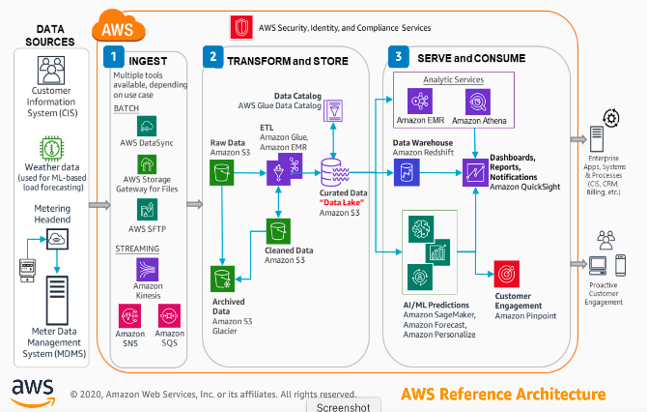
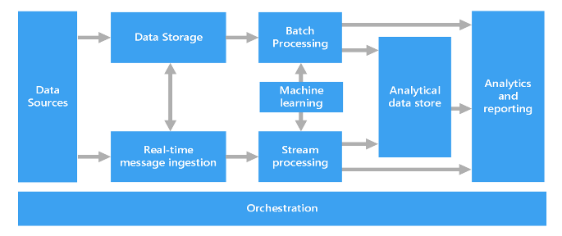
Industry reference architectures
IBM Event-driven Architecture
AWS Utilities Reference Architecture
Azure Big Data Reference Architecture

